Slide 1
Medical Appointment No-Show Prediction
AJAY RAMA RAJU DATLA (Z1979893)
JAYA SANDEEP BATHINA (Z1976378)
CHAKRAFANI CHADALAVADA(Z2007545)

Slide 2
Problem Statement:
The problem is to predict whether a patient will show up or not show up for their medical appointment based on various patient and appointment-related factors.
Research question: "What factors influence no-show rates, and how accurately can we predict whether a patient will attend their scheduled appointment?"

Slide 3
Why it is Important to address?
01
02
03
04
Improving healthcare efficiency
Optimizing resource allocation
Cost reduction
Saving Time

Slide 4

Dataset Overview

Slide 5
Dataset Overview:
Dataset: It includes details on patient demographics, appointment schedules, health history, and external factors like reminders.
Number of Columns: 15
Number of rows: 100,000
Link to dataset: https://www.kaggle.com/datasets/wajahat1064/healthcare-appointment-dataset

Slide 6
Dataset Overview
01
Demographics
Age, Gender, Neighborhood
02
Appointment Details
ScheduledDay, AppointmentDay, Date.diff
03
Medical History
Hypertension, Diabetes, Alcoholism, Handicap
04
Reminders
SMS received
05
Target (Y)
No-show

Slide 7
Approach

Slide 8
Data and Model:
1. Data Pre-processing:
Handle missing values, encode categorical variables, and normalize numerical features.
2. Feature Engineering:
Created new feature: Date.diff
3. Machine Learning Models:
- Neural Network Model
- Random Forest Classifier

Slide 9
Machine Learning Models

Slide 10
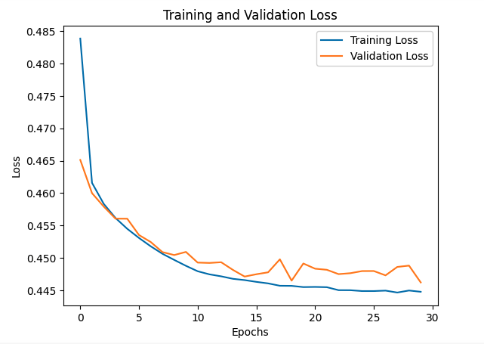
Model 1:Neural Network
Input Layer
4 Hidden Layers
Output Layer
16 Neurons, ReLu Activation
Relu Activation
1 neurons, Sigmoid Activation
After 30 Epochs (Training Cycles):
Test Accuracy: 79.82%
F1-Score: 71%
-Indicates a decent balance between precision and recall

Slide 11
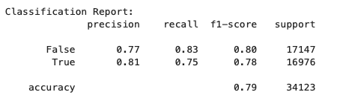
Model 2:Random Forest
1. Data: Used only 11 columns on this model as 4 others were not a significant predictors.
2. SMOTE: For oversampling the minority class.
Evaluation Results:
Test Accuracy: 79%
Precision (True label): 81%
Recall (True label): 75%
Notes:
Out of all the instances the model predicted as “True” (showed up), 81% were actually True
Out of all the actual “True” instances (patients who really showed up), 75% were correctly identified by the model.

Slide 12
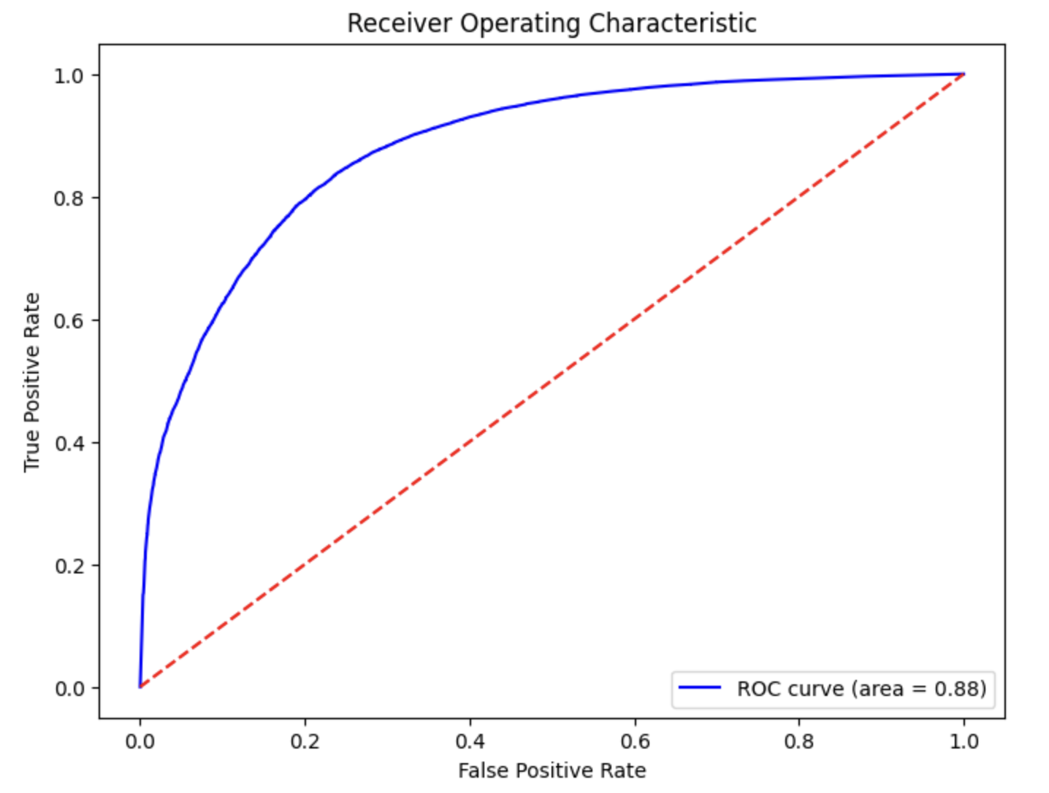
Model 2:Random Forest
The model achieved a good balance between high TPR and low FPR.
An AUC of 0.88 means the model has an 88% chance of correctly distinguishing between the positive and negative classes.
Notes:
AUC = Area Under the curve

Slide 13
Conclusion:
Both models achieved approximately 79% accuracy.
Neural Network excels in capturing complex relationships.
Random Forest provides more interpretability and handles imbalanced data effectively.
Future Scope: Explore other algorithms (e.g., Gradient Boosting), optimize hyperparameters, and incorporate external factors like weather or traffic.

Slide 14
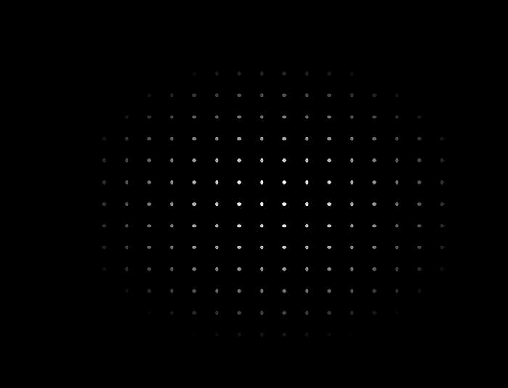
Thanks!
Do you have any questions?

